Slide 1
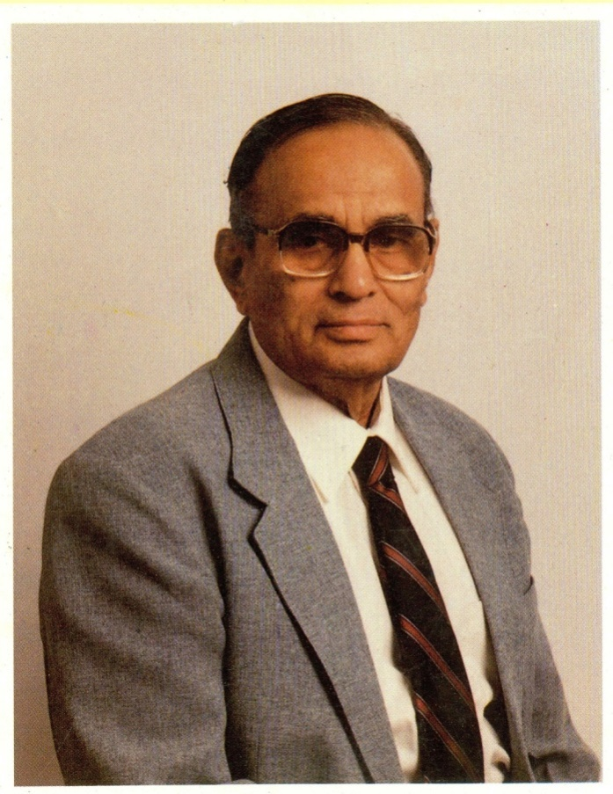
Dr M.P. Pai
Early education in Mangalore
MBBS from I batch, Stanley Medical College, Madras
MS from Madras Medical College, Madras
FRCS, Edinburgh , Eminent surgeon
Extraordinary teacher
1919 to 1992

Slide 2
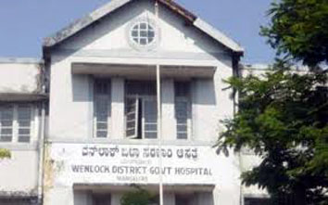
Dr M.P. Pai
Extraordinary teacher
Going to Assam for a Teaching Job
Joined KMC as a Professor of Operative Surgery
Principal of KMC, Mangalore

Slide 3
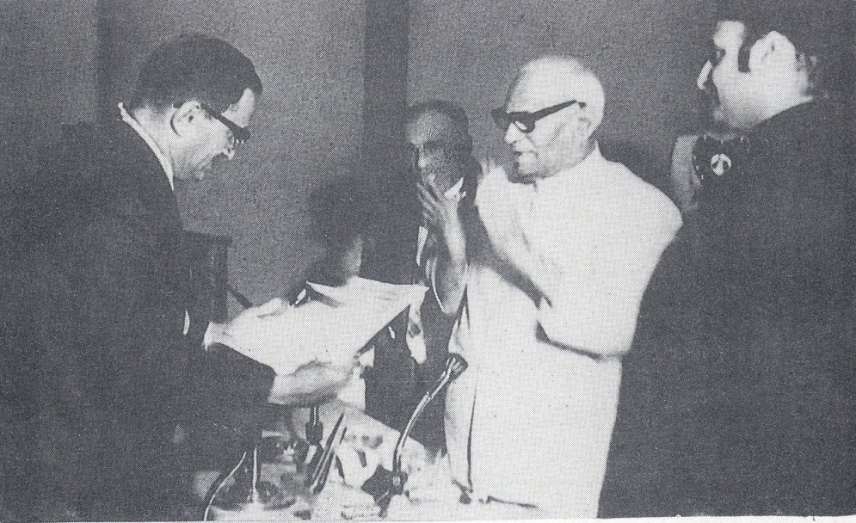
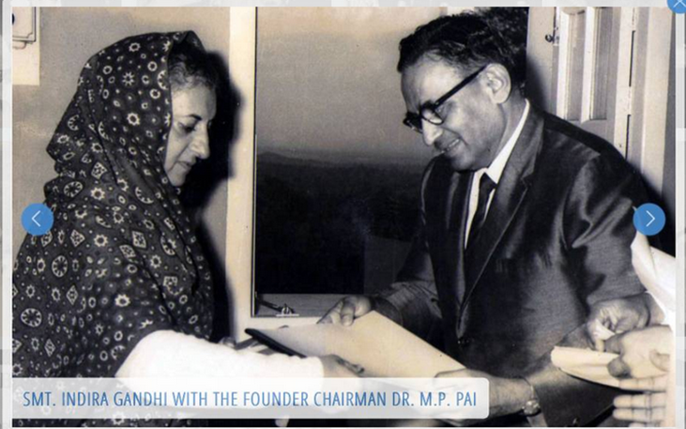
Dr B.C. Roy Award

Slide 4
Dr M.P. Pai
Surgical leadership
First one to start MS (Surg) course, Karnataka @ KMC
Organised Annual Conference of ASI 1967, Manipal
Established a “Burns Ward” in Kasturba Hospital, Manipal

Slide 5
27th Annual All India Surgeons Conference, Manipal 1966

Slide 6
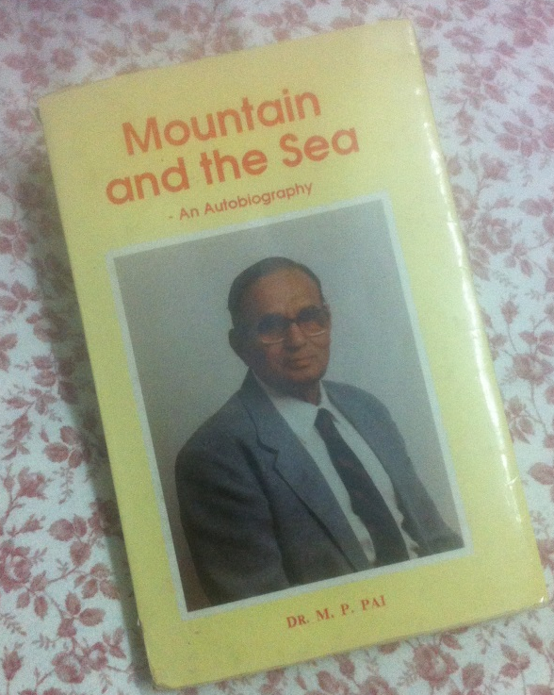
An Autobiography

